Slide 1
New X-factors: Rooftop solar and electric mobility
Neeraj Kuldeep
Energy Horizons 2019, New Delhi
19 July 2019
© Council on Energy, Environment and Water, 2019

Slide 2
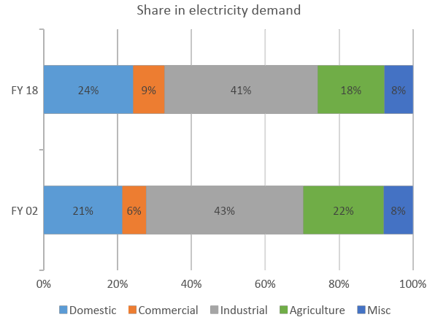
Residential sector will drive growth in energy demand
Rapid urbanisation
  40 per cent urban population in 2030
Higher per capita energy consumption
  Increasing at 4.8 per cent CAGR
Increasing ambient temperature and AC usages
  AC stock to increase to 170 million in 2027 and 1 billion in 2050
Increasing car ownership
  20 cars to 175 cars per 1000 people by 2040
India’s electric vehicle mission
  30% of new vehicle sales from electric vehicle by 2030
Source: IEA (2018)

Slide 3
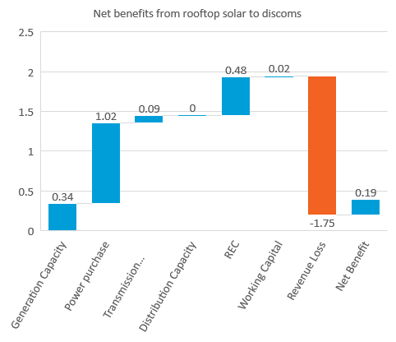
Rooftop solar and electric vehicles have economy-wide benefits
Rooftop solar
  USD 40 billion market opportunity by 2022
  Employment to 2,38,000 people from 40GW rooftop solar capacity
  Employment is distributed across states
Economic gain to discoms from rooftop solar.
  INR 0.19/kWh from rooftop solar generation
Electric vehicles
  Domestic value add is ~USD 17 billion by 2030
  About 5.4 billion USD annual savings from reduced oil imports
  Employment to 191,600 for 30 per cent EV penetration scenario
Reduced local air pollution and avoided health cost
Source: CEEW 2019, CPI 2018, Scaling up Rooftop Solar Power in India: The Potential of Solar Municipal Bonds,

Slide 4
Many support mechanisms for the sector are already in play…
Capital subsidies
Fame 2 scheme
Consumer awareness
Support mechanisms
Tax subsidies
Supporting regulatory framework
New business model

Slide 5
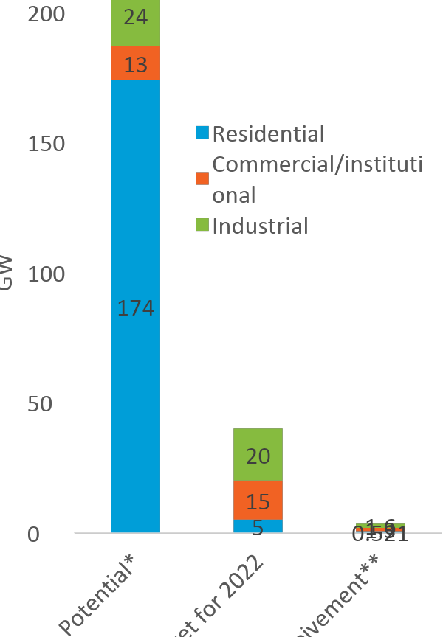
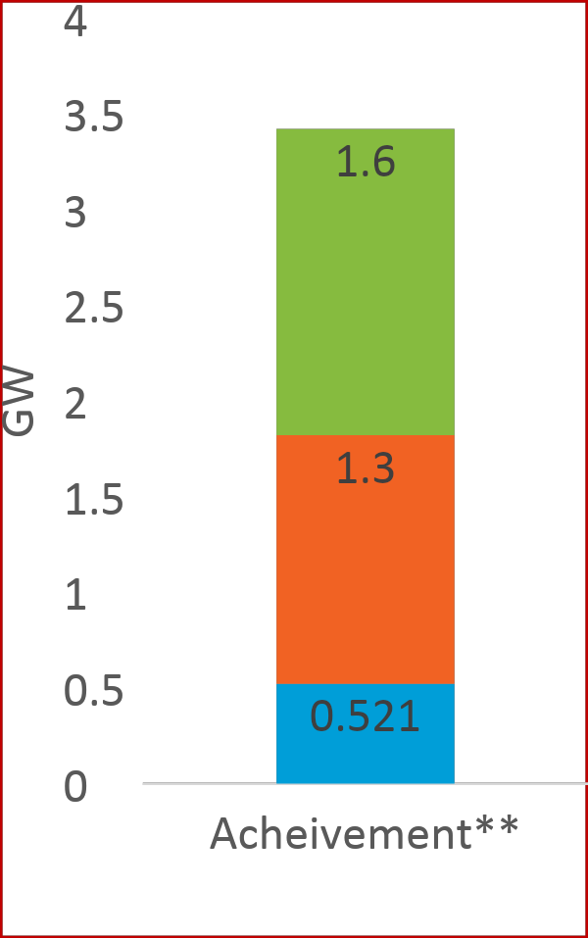
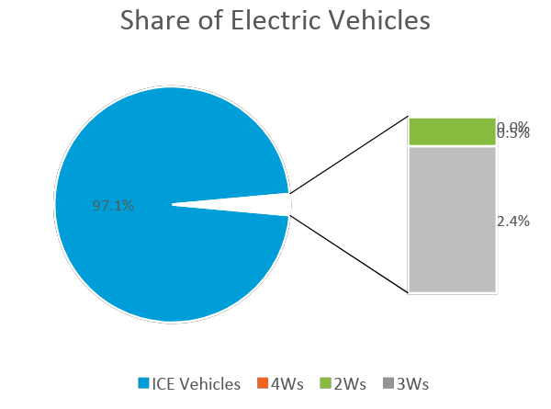
Limited demand from consumers so far
Rooftop solar deployment
*Realistic technical potential in urban areas – estimated from built-up area data
** As of September 2018.
TERI (2014) Reaching the Sun with Rooftop Solar, New Delhi: The Energy and Resource Institute, p. 62.
Bridge to India (2018) “India Solar Rooftop Map 2018,” available at https://bridgetoindia.com/reports/, accessed on 12 February 2019

Slide 6
Many challenges to adoption
Lack of awareness
High upfront cost
Lack of access to easy financing
Small and distributed nature
Lack of available infrastructure
Difficulty in choosing trust-worthy service providers

Slide 7
Thank you
Join the conversation by using #EnergyHorizons
ceew.in | @CEEWIndia

Slide 8
Many support mechanisms for the sector are already in play…
Capital subsidies
  Subsidy incentives to consumers
  SHRISTI scheme for discoms
Consumer awareness campaigns
Supporting regulatory framework
  Net-metering and gross-metering
New business models
Tax subsidies
FAME 2 scheme
Capital subsidies
Fame 2 scheme
Consumer awareness
Support mechanisms
Tax subsidies
Supporting regulatory framework
New business model

