Slide 1
Curtailing curtailment
Manu Aggarwal
Energy Horizons 2019
New Delhi
19 July 2019
© Council on Energy, Environment and Water, 2019

Slide 2
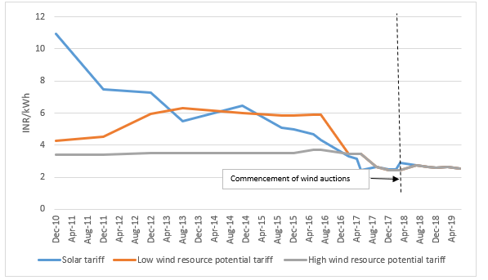
Indian renewable energy tariffs are one of the lowest in the world
Source: CEEW CEF, Central Electricity Regulatory Commission (CERC) Tariff Orders

Slide 3










Are these low tariffs sustainable?
Source: Indian dailies

Slide 4
Does curtailment even exist?
Quantum of Curtailment
Difficult to estimate quantum of curtailment – it is a function of location and time period
Granular data available but not public
Only Gujarat and Chhattisgarh used to publish data but stopped publishing data after July-2017
Nature of Curtailment is changing from commercial to technical
175 GW of RE by 2022 and more
Type of curtailment based on RE tariffs
 | Newly Awarded Capacity (Tariff < INR 3/kWh) | Intermediate RE Capacity (INR 3/kWh <Tariff< INR 5/kWh) | Old RE Capacity (Tariff > INR 5/kWh)
Type of curtailment | Predominantly technical | Technical and some commercial | Both technical and commercial
Source: CEEW CEF

Slide 5
What is government trying to do?
Regulatory interventions
Forecasting and Scheduling regulations
Increasing balancing area
CERC papers on electricity markets including ancillary markets
Technical interventions
Storage tenders
flexible thermal - bundling
Grid strengthening
Dedicated RE monitoring centres such as the Renewable Energy Management Centres

Slide 6
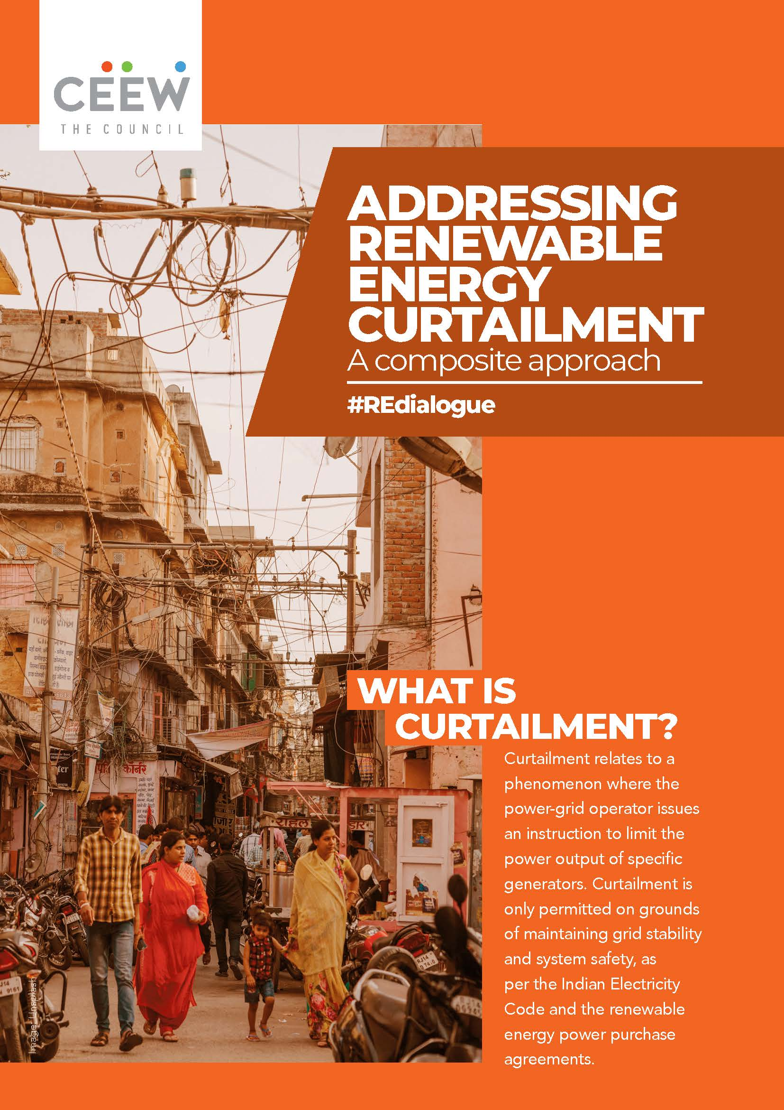
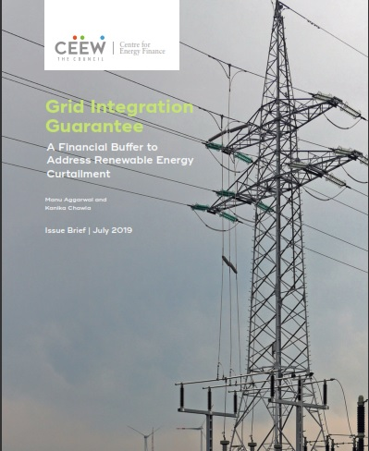
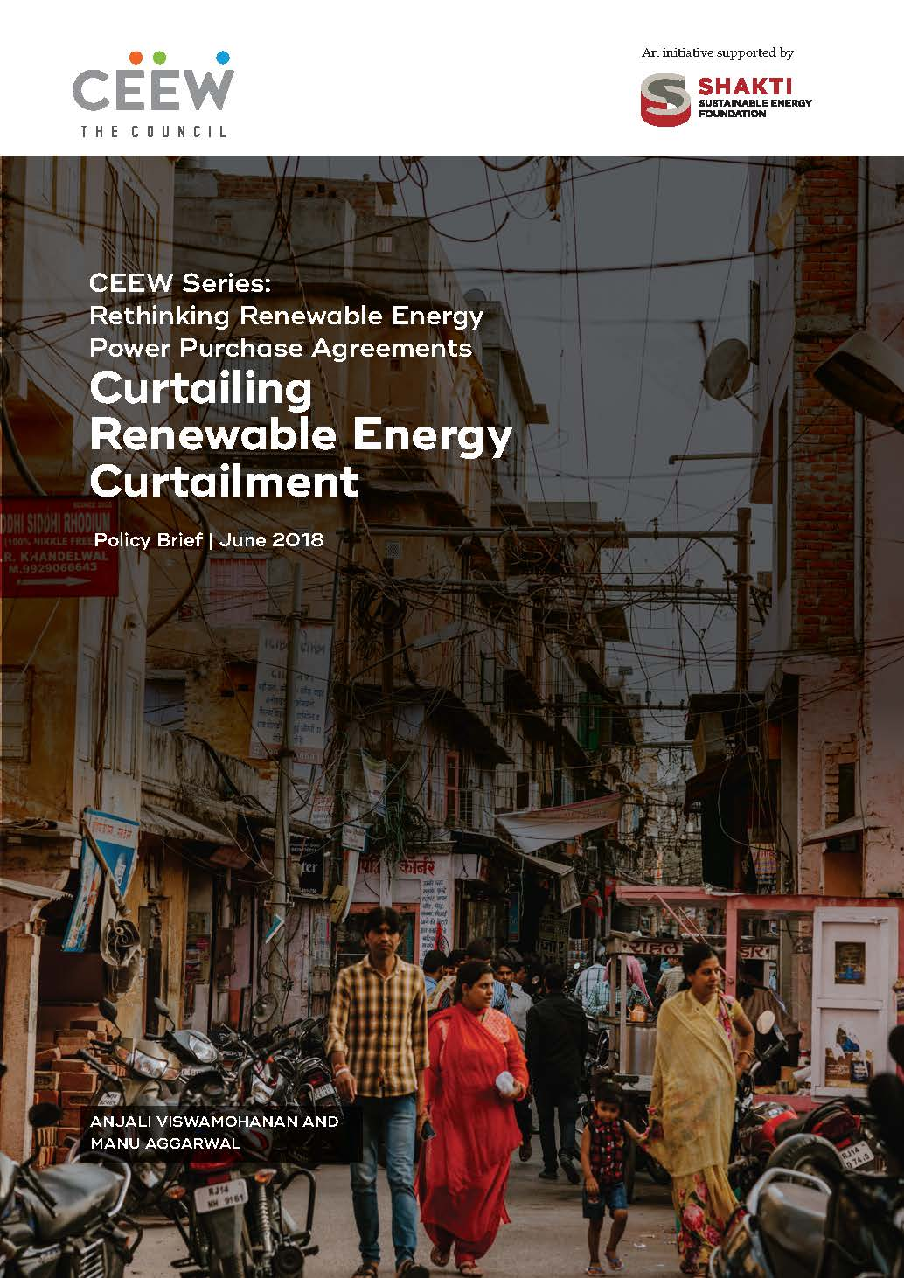
What is CEEW CEF trying to do?
CEEW CEF proposes two-fold interventions that would lead to the efficient allocation of risks in both short to medium and long term
  For short to medium term, a stop-gap measure called Grid Integration Guarantee (GIG)
  Effective contractual provisions to limit and compensate for curtailment, making it a more predictable risk in medium and long term
Source: CEEW CEF

Slide 7
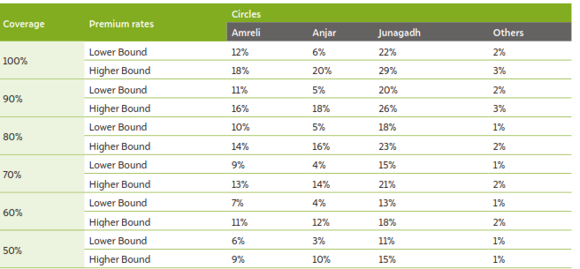
Grid Integration Guarantee
Use case is ready but availability of data is a challenge
Insurance/risk mitigation product that leverages big data and actuarial science
Covers only curtailment and not resource and performance risks
Covers the tail-end curtailment risk with market reflective pricing
Capitalisation- Premiums, public money from governments, GCF, etc.
Other than the obvious risk underwriting, additional merits of GIG are:
  Predict the feasible pace of renewable capacity addition
  Helps quantify the cost of grid integration
Source: CEEW CEF

Slide 8
Thank you
Join the conversation by using #EnergyHorizons
ceew.in | @CEEWIndia

Slide 9
Guiding questions
What is the extent and nature of curtailment in new solar and wind plants in India?
How is curtailment risk factored into the long-term business plan of newer projects? How is this different from older RE projects?
Do governments know everything about curtailment to underwrite it?
How should government underwrite curtailment risk- PPAs and/or GIG?
Source: CEEW CEF

