Slide 1

Grid integration of rooftop solar: An economic loss/gain to discom?
Akanksha Tyagi, Neeraj Kuldeep, Selna Saji
Energy Horizons 2019
New Delhi
18 July 2019
Session Partner
© Council on Energy, Environment and Water, 2019 and BSES Rajdhani Power Limited (BRPL)

Slide 2
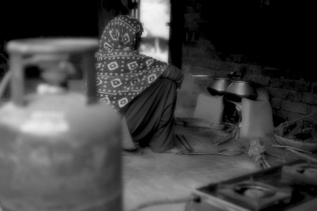

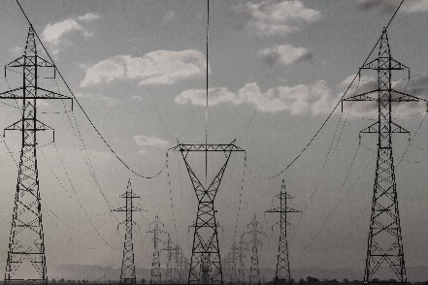
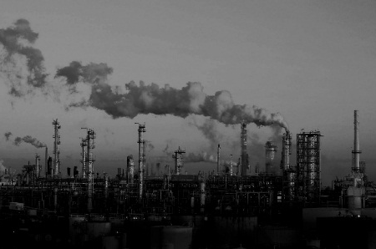


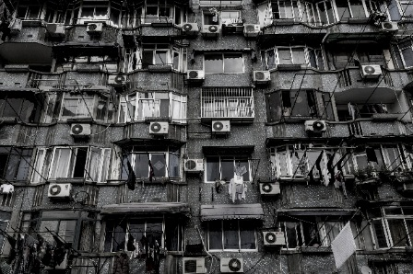

CEEW – Among South Asia’s leading policy research institutions
^{Energy Access}
^{Renewables}
^{Power Sector}
Industrial Sustainability & Competitiveness
^{Low-Carbon Pathways}
^{Risks & Adaptation}
^{Technology, Finance, & Trade}
^{Centre for Energy Finance}

Slide 3
Agenda
Introduction (5 min)
Methodology (20 min)
Case study (15 min)
Tool demonstration (30 min)

Slide 4
Introduction

Slide 5
Introduction
India’s rooftop solar sector
40 GW national target for rooftop solar by 2022
3.8 GW installed capacity of rooftop solar as of FY19¹
Maharashtra
Rajasthan
Tamil Nadu
Gujarat
Karnataka
1. CEEW compilation from multiple sources: MNRE, Bridge to India, Mercom

Slide 6
Introduction
Rooftop solar and discoms
Challenges
Opportunities
Revenue loss
Inadequate technical staff
Infrastructure upgradation
Inequitable billing methods
Demand management
RPO targets
Network decongestion
Reduction in T&D losses
Need for improved solar valuation methods
Discom: Distribution companies; T&D losses : transmission and distribution losses; RPO: renewable purchase obligation
Notes:
Inequitable billing methods: gross, net, virtual: volumetric and Uniform feed-in tariff (location, time not imp): loss to discom: peak or non-peak ; loading of DT
Infra: dt cap, grid balancing, intermittent nature of solar
Lack of incentives: Transmission charges are exempted

Slide 7
Introduction
Value of grid-connected rooftop solar (VGRS)
Cost-benefit analysis method
Location and time specific
Equitable compensation of solar electricity
Flexibility to choose different perspectives: discom, consumer, society
Notes:
Uniform feed-in tariff (location, time not imp): loss to discom: peak or non-peak ;
loading of DT

Slide 8
Introduction
Relevance of VGRS to discom
Efficient demand and supply management
Wiser investments for grid upgradation
Strategic deployment of rooftop solar projects
Support for equitable solar tariffs and operational incentives
Notes:
Uniform feed-in tariff (location, time not imp): loss to discom: peak or non-peak ;
loading of DT

Slide 9
Methodology

Slide 10
VGRS methodology
Identify benefits and costs of rooftop solar to discom
Define framework
Estimate net benefit and cost
Case study and tool demonstration

Slide 11
Costs and benefits of rooftop solar to discoms
Costs
Benefits
Revenue loss
Program administration cost
Added transmission and distribution services cost
Generation
Avoided generation capacity cost (AGCC)
Avoided power purchase cost (APPC)
Transmission
Avoided transmission charges
Distribution
Avoided distribution capacity infrastructure and related O&M cost
Externalities
Avoided renewable energy certificate cost
Reduced working capital

Slide 12
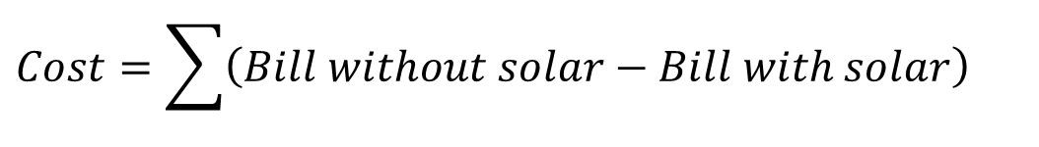
Costs of rooftop solar to discom
  Revenue loss
Migration of consumers from grid to rooftop solar
Reduction in DISCOM’s receivables
$$Cost=\sum{\left(Bill without solar−Bill with solar\right)}$$
Data requirement
Variable tariff and load profile of each consumer category
Rooftop solar data: number and capacity of rooftop solar, solar generation profile

Slide 13
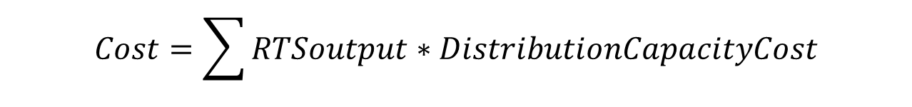
Costs of rooftop solar to discom
  Added transmission and distribution services cost
Additional network component required to evacuate and manage rooftop solar
Expenses to install and maintain new network components
Constraint: Depends on when new components will be added
$$Cost=\sum{RTSoutput∗DistributionCapacityCost}$$
Data requirement
Cost of procuring and maintaining new network components
Rooftop solar data: number and capacity of rooftop solar

Slide 14
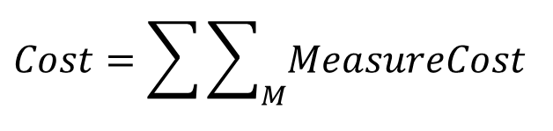
Costs of rooftop solar to discom
Program administration cost
Technical staff recruitment, site visits, panel cleaning
Additional expenses to discom
$$Cost=\sum{\sum_{M}{MeasureCost}}$$
Data requirement
Salary of additional technical staff recruited for rooftop solar
Cost of all programs specific to rooftop solar

Slide 15
Are there additional cost parameter?

Slide 16
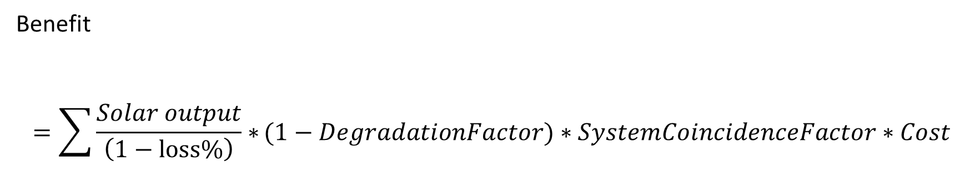
Benefits of rooftop solar to discom
General formula of evaluating benefit
Benefit
$$=\sum{\frac{Solar output}{\left(1−loss\%\right)}∗}(1−DegradationFactor)∗SystemCoincidenceFactor∗Cost$$
System
(generation/ transmission/ distribution)
Rooftop solar

Slide 17
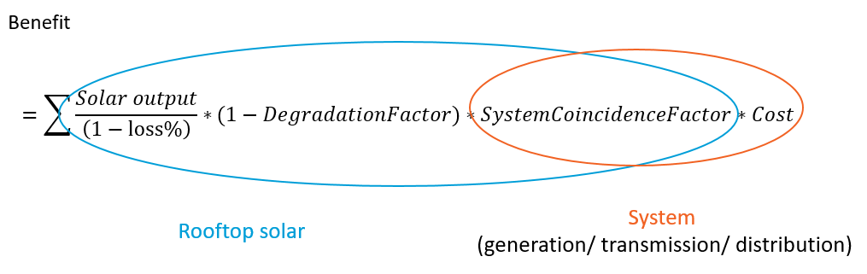
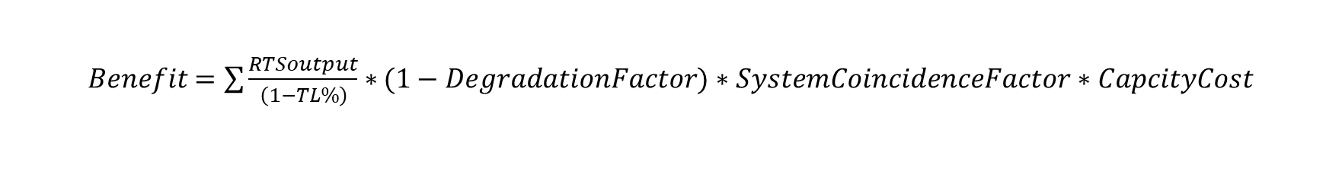
Benefits of rooftop solar to discom
Avoided generation capacity cost (AGCC)
Reduced generation capacity requirement
Savings on the fixed cost
Constraint: Depends on when power purchase agreement (PPA) with genco is due
$Benefit$ $=\sum{\frac{RTSoutput}{\left(1−TL\%\right)}∗}(1−DegradationFactor)∗SystemCoincidenceFactor∗CapcityCost$
Data requirement
Cost of the procured capacity from the genco
Load profile
Transmission loss (TL)
Rooftop solar data: number and capacity of rooftop solar, solar generation profile
Genco: generation company

Slide 18
Benefits of rooftop solar to discom
Avoided power purchase cost (APPC)
Reduced power requirement
Savings on the variable cost
Constraint: none
$Benefit$ $=\sum{\frac{RTSEnergy}{\left(1−TL\%\right)(1−DL\%)}∗}$ $VariablePowerPurchaseCost$
Data requirement
Variable component of power purchase cost (open access and merit order)
Transmission and distribution losses (TL, DL)
Rooftop solar data: number and capacity of rooftop solar

Slide 19
Benefits of rooftop solar to discom
Avoided transmission charges (ATRC)
Reduced transmission capacity requirement
Savings on the transmission charges
Constraint: Depends on when power purchase agreement (PPA) with TRANSCO is due
$$Benefit$$
$$=\sum{\frac{RTSoutput}{\left(1−TL\%\right)\left(1−DL\%\right)}∗}(1−DegradationFactor)∗TransmissionCoincidenceFactor∗TransmissionCapcityCost$$
Data requirement
Transmission charges payable to the transco
Load profile
Transmission and distribution losses (TL, DL)
Rooftop solar data: number and capacity of rooftop solar, solar generation profile
Transco: transmission company

Slide 20
Benefits of rooftop solar to discom
  Avoided distribution capacity infrastructure and related O&M cost (ADCC)
Delayed distribution transformer (DT) upgradation
Savings on upgradation and maintenance
Constraint: Depends on when DT upgradation is due
$$Benefit$$
$$=\sum{\frac{RTSoutput}{\left(1−TL\%\right)\left(1−DL\%\right)}∗}(1−DegradationFactor)∗DistributionCoincidenceFactor∗DistributionCapcityCost$$
Data requirement
DT load profile
Cost to install, operate and maintain the new DT
Transmission and distribution losses (TL, DL)
Rooftop solar data: number and capacity of rooftop solar, solar generation profile
O&M: operation and maintenance

Slide 21

Benefits of rooftop solar to discom
  Avoided renewable energy certificate cost
Available solar generation enough to meet renewable purchase obligation (RPO) targets
Savings on renewable energy certificates (RECs)
Constraint: Depends on the validity of RECs in future
$Benefit =\sum{RTSEnergy∗}$ $RECCost$
Data requirement
Cost of RECs
Rooftop solar data: number and capacity of rooftop solar, solar generation profile

Slide 22
Are there additional benefit parameters?

Slide 23
Costs and benefits of rooftop solar to discoms
Costs
Benefits
Revenue loss
Program administration cost
Added transmission and distribution services cost
Generation
Avoided generation capacity cost (AGCC)
Avoided power purchase cost (APPC)
Transmission
Avoided transmission charges
Distribution
Avoided distribution capacity infrastructure and related O&M cost
Externalities
Avoided renewable energy certificate cost
Reduced working capital
Which component contributes most?

Slide 24
Challenges in VGRS
Feedback
Comprehension
Multiple components
Data availability
Granular data required
Data accuracy
Long term projections
Computation limitations
Scaling up the analysis from DT level to the entire service area

Slide 25
Case study

Slide 26
Selection of distribution transformers
Rated Capacity
100 kVA
Peak Loading
Low
High
RTS penetration
Low (<10 per cent)
High (>10 per cent)
Consumer category
Residential
Industrial
Commercial
Government
Institutional
630 kVA
990 kVA

Slide 27
Selection of distribution transformers
 | DT 1 | DT 2 |  | DT 3 | DT 4 | DT 5 | DT 6 | DT 7 | DT 8
DT capacity (kVA) | 100 | 630 |  | 990 | 100 | 100 | 990 | 990 | 990
Total RTS capacity considered (kW) | 35 | 220 |  | 102 | 10 | 80 | 10 | 30 | 63.3
Individual RTS capacities (kW) | 35 | 20 | 200 | 102 | 10 | 80 | 10 | 30 | 63.3
Consumer category | Industrial | Commercial | Government | Commercial | Residential | Institutional | Residential | Government | Institutional
DCF | 27.09% | 36.14% | 33.57% | 7.38% | 19.10% | 37.25% | 14.86% | 20.10% | 5.51%

Slide 28
Contribution of rooftop solar in peak reduction at DT level

Slide 29
Results

Slide 30
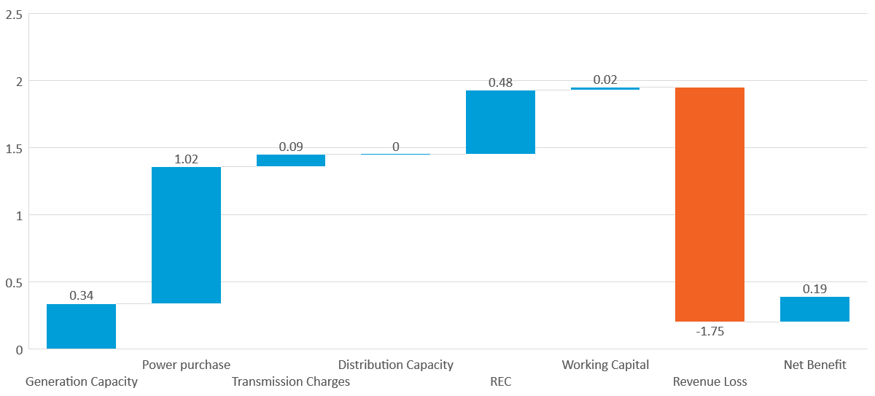
Net benefit from rooftop solar to discoms

Slide 31
Utility-level scaling
ADCC has been ignored in the calculations

Slide 32
Key observations and recommendations
Rooftop solar systems contribute to reducing a discom’s peak demand by about 13 per cent of its rated capacity.
Savings on power procurement and REC costs constitute about 77 per cent of the overall benefits to the discom.
Residential DTs in the BRPL area offered a maximum net gain of INR 0.86/kWh in case of high-rise societies with single point delivery of electricity.
Revenue loses in residential category is in the range of INR 1.08–1.86 for every unit of solar electricity generated compared to INR 1.74 and INR 1.92 in the industrial and commercial categories, respectively.
Discoms should promote rooftop solar systems among their subsidised consumer categories to maximise their benefits.
DTs with frequent overloading and day time peaks serve as useful targets for rooftop solar deployment to further improve the net benefit.

Slide 33
Tool Demonstration tinyurl.com/CEEWtool

Slide 34
Suggested values for input parameters
Parameter | Values
Annual derating | 0.5% - 0.8%
Distribution coincidence factor | 15% - 30%
Fixed capacity cost | 10,000 – 15,000
Average peak energy procurement cost | 4 – 5
Average non-peak energy procurement cost | 2 – 4
Transmission charges | 2,000 – 4,000
DT upgradation costs | 8,00,000 – 13,00,000
WACC | 13% - 17%
Debt rate | 12% - 14%

Slide 35
Thank you
Join the conversation by using #EnergyHorizons
ceew.in | @CEEWIndia

Slide 36
Benefits of rooftop solar to DISCOM
  Reduced working capital
Available solar generation enough to meet renewable purchase obligation (RPO) targets
Savings on renewable energy certificates (RECs)
Constraint: Depends on the validity of RECs in future
$${Benefit}_{Y}=\frac{Δ\left(2∗RevenueLoss−AvoidedCosts\right)}{12}∗DebtRate$$
Data requirement
Consumer categories and tariffs
Debt rate
TRANSCO: transmission company

Slide 37
Estimate net benefit and cost
Case study: a distribution transformer (DT) in BRPL service area
Discom data
Capacity procurement cost
Power Purchase cost
Projected growth rate of load
Capacity of the current DT and planned upgradation
One-time cost of upgradation of the DT
Category and consumption details (before and after solar)of consumers
Tariff escalation rate
Transmission and distribution Losses
Renewable energy certificate (REC) cost

Slide 38
Estimate net benefit and cost
Case study: a distribution transformer (DT) in BRPL service area
Rooftop solar data
Number of rooftop solar projects planned
Rated capacity of rooftop solar
Solar generation data
Program cost
Capacity utilization factor
System coincidence factor

Slide 39
Estimate net benefit and cost
Case study: a distribution transformer (DT) in BRPL service area
DT characteristics
CUF: 9.07%
Installed RTS capacity: 50 kW
Consumer category: Residential
SCF: 3.02%
DCF: 2.11%

Slide 40
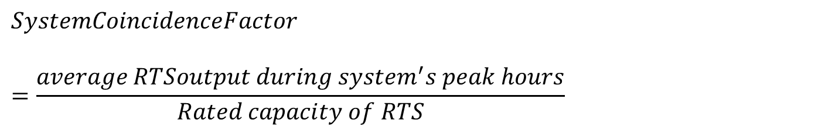
Assign monetary value to identified components
Calculating the SystemCoincidenceFactor
$$SystemCoincidenceFactor$$
$$=\frac{average RTSoutput during system^{′}s peak hours}{Rated capacity of RTS}$$
Use hourly data of the demand as seen by the system for the past year.
Identify the top 20% hours when the demand was the highest.
Identify RTS production during these peak hours and take their average
Divide 3 by the rating of the RTS installation to get the SystemCoincidenceFactor for that system (generation/transmission/ distribution)

Slide 41
Assign monetary value to identified components
Example: SystemCoincidenceFactor for generation and transmission system

Slide 42
Assign monetary value to identified components
Example: SystemCoincidenceFactor for generation and transmission system

Slide 43
Estimate net benefit and cost
Case study: a distribution transformer (DT) in BRPL service area
Assumptions
Average capacity and power procurement cost
Overall utility demand (generation and transmission) for DT level analysis
Same SystemCoincidenceFactor for generation and transmission system
Transmission cost is ratio of total transmission charges and capacity contracted
Policy on RECs remains unchanged for 25 years

Slide 44
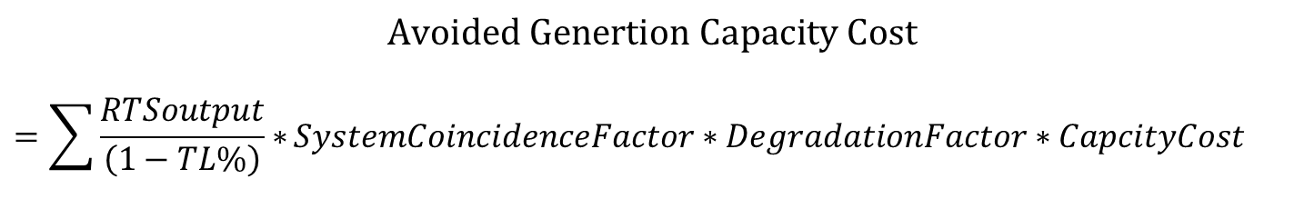
Estimate net benefit and cost
$$Avoided Genertion Capacity Cost$$
$$=\sum{\frac{RTSoutput}{\left(1−TL\%\right)}∗}SystemCoincidenceFactor∗DegradationFactor∗CapcityCost$$
Parameter | Unit | Description | Value
RTS output | kW | Rated capacity of the RTS | 35
System Coincidence Factor |  | Fraction of rated RTS output that supports the system at the latter’s peak. | 0.1434
Degradation Factor |  | Factor to account for the decrease in performance of the RTS system over the years | 0.995^{Y-1}
Capacity Cost | INR/kW | Fixed cost of additional contracted capacity as decided by the Regulatory commission | 7452.23
TL% |  | Transmission loss per cent | 3.30%

Slide 45
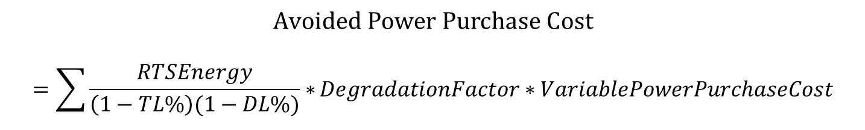
Estimate net benefit and cost
$$Avoided Power Purchase Cost$$
$$=\sum{\frac{RTSEnergy}{\left(1−TL\%\right)(1−DL\%)}∗}DegradationFactor∗VariablePowerPurchaseCost$$
Parameter | Unit | Description | Value
RTS Energy | kWh | Electricity produced by the RTS system in the first year | 38,625
Degradation Factor |  | Factor to account for the decrease in performance of the RTS system over the years | 0.995^{Y-1}
Var. Power Purchase Cost | INR/kWh | Variable component of the power purchase cost of the DISCOM as set by the regulatory commission | 2.81
TL% |  | Transmission loss per cent | 3.30%
DL% |  | Distribution loss per cent | 9.50%

Slide 46
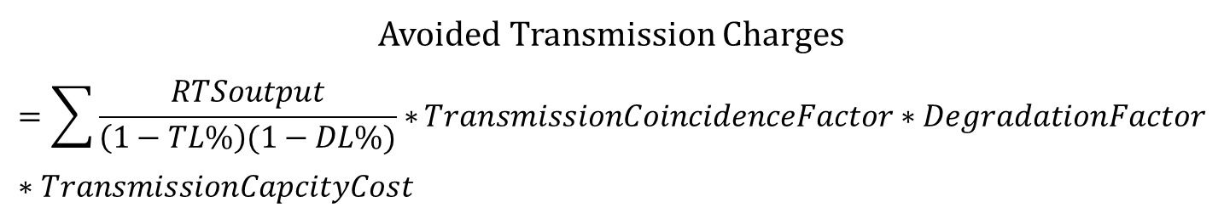
Estimate net benefit and cost
Avoided Transmission Charges
$$=\sum{\frac{RTSoutput}{\left(1−TL\%\right)(1−DL\%)}∗}TransmissionCoincidenceFactor∗DegradationFactor∗TransmissionCapcityCost$$
Parameter | Unit | Description | Value
RTS output | kW | Rated capacity of the RTS | 35
Trans. Coincidence Factor |  | Fraction of rated RTS output that supports the transmission system at the latter’s peak. | 0.1434
Degradation Factor |  | Factor to account for the decrease in performance of the RTS system over the years | 0.995^{Y-1}
Transmission Cap. Cost | INR/kW | Normative transmission charges as decided by the Regulatory commission | 2970.15
TL% |  | Transmission loss per cent | 3.30%
DL% |  | Distribution loss per cent | 9.50%

Slide 47
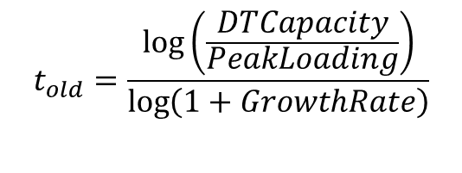
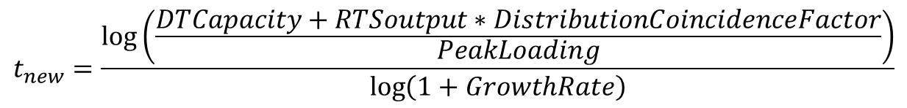
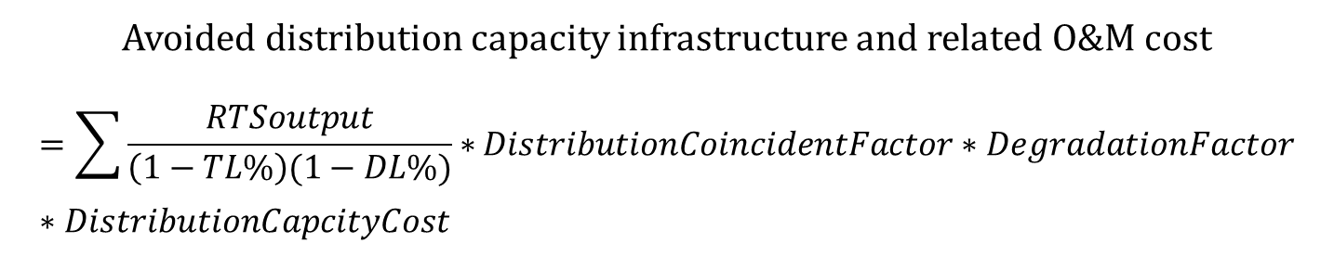
Estimate net benefit and cost
Avoided distribution capacity infrastructure and related O&M cost
$$=\sum{\frac{RTSoutput}{\left(1−TL\%\right)(1−DL\%)}∗}DistributionCoincidentFactor∗DegradationFactor∗DistributionCapcityCost$$
Time deferred to upgrade DT
$$t_{old}=\frac{\log\left(\frac{DTCapacity}{PeakLoading}\right)}{\log\left(1+GrowthRate\right)}$$
$$t_{new}=\frac{\log\left(\frac{DTCapacity+RTSoutput∗DistributionCoincidenceFactor}{PeakLoading}\right)}{\log\left(1+GrowthRate\right)}$$

Slide 48
Estimate net benefit and cost
Avoided distribution capacity infrastructure and related O&M cost
Parameter | Unit | Description | Value
RTS output | kW | Rated capacity of the RTS | 35
Distribution Coincidence Factor |  | Fraction of rated RTS output that supports the distribution transformer at the latter’s peak. | 0.1353
Degradation Factor |  | Factor to account for the decrease in performance of the RTS system over the years | 0.995^{Y-1}
DT Capacity | kVA | Rated capacity of the distribution transformer | 100
Peak Loading | kVA | 90th percentile DT loading in the last one year | 89.3734
Growth Rate |  | Category-wise annual growth rate mentioned in the ARR | 2.6%

Slide 49
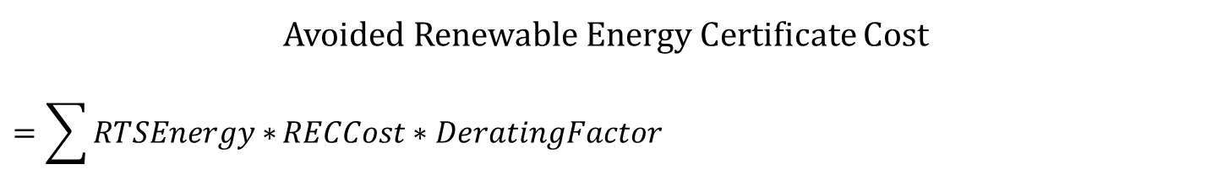
Estimate net benefit and cost
Avoided Renewable Energy Certificate Cost
$$=\sum{RTSEnergy∗}RECCost∗DeratingFactor$$
 | Unit | Description | Value
RTS Energy | kWh | Electricity produced by the RTS system in the first year | 38,625
REC Cost | INR/kWh | Cost of purchasing solar REC | 2
Derating Factor |  | Factor to account for the decrease in performance of the RTS system over the years | 0.995^{Y-1}

Slide 50
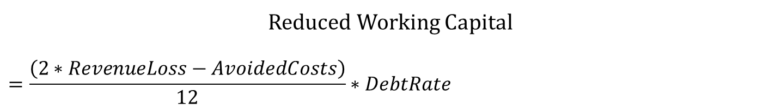
Estimate net benefit and cost
Reduced Working Capital
$$=\frac{\left(2∗RevenueLoss−AvoidedCosts\right)}{12}∗DebtRate$$
 | Unit | Description | Value
Revenue Loss | INR | Loss to the utility’s revenue due to adoption of rooftop solar by consumers
Avoided Costs | INR | Sum of all benefits stated prior to this
Debt Rate |  | The interest rate faced by the utility to finance debts | 14%

Slide 51
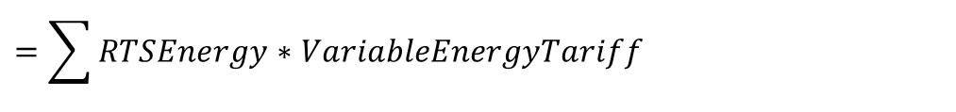
Estimate net benefit and cost
Revenue loss
$$=\sum{RTSEnergy∗VariableEnergyTariff }$$
VariableEnergyTariff (INR/kWh): The variable energy tariff for consumers as approved by the regulatory commission
 | Unit | Description | Value
RTS Energy | kWh | Electricity produced by the RTS system in the first year | 38,625
Variable energy tariff | INR/kWh | The variable energy tariff for consumers as approved by the regulatory commission | 4.5

Slide 52
Estimate net benefit and cost
Added transmission and distribution services cost
No data provided
Program administer cost
No data provided

Slide 53
Net present value
Benefits (INR/kWh):
Avoided generation capacity cost | 0.20
Avoided power purchase cost | 0.77
Avoided transmission charges | 0.09
Avoided distribution capacity cost | -
Avoided renewable energy certificate cost | 0.48
Reduced working capital | 0.01
Total Benefits | 1.54
Costs (INR/kWh):
Program Administer Cost |  | -
Revenue Loss |  | 1.08
Added transmission and distribution services cost |  | -
Total Costs |  | 1.08
Net benefit/cost |  | 0.46

