Slide 1




Employment opportunities, distribution, and gender participation in renewable energy sector
Madhura Joshi, NRDC
Shaily Jha, CEEW
Energy Horizons 2019
New Delhi, India
18 July 2019
Session Partners
© Council on Energy, Environment and Water, 2019, Power For All, Skill Council for Green Jobs and Natural Resources Defense Council

Slide 2
Powering Jobs Growth with Green Energy
Employment in the Solar and Wind Sectors

Slide 3




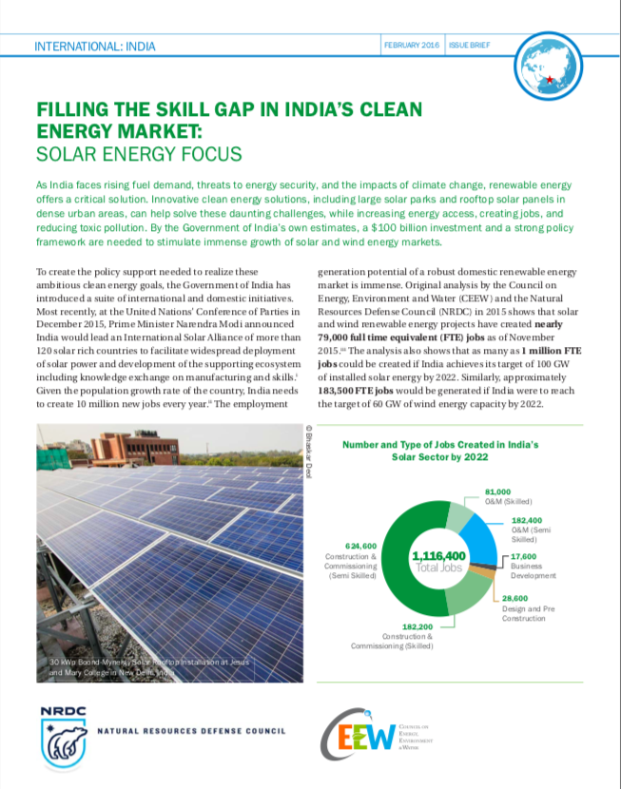


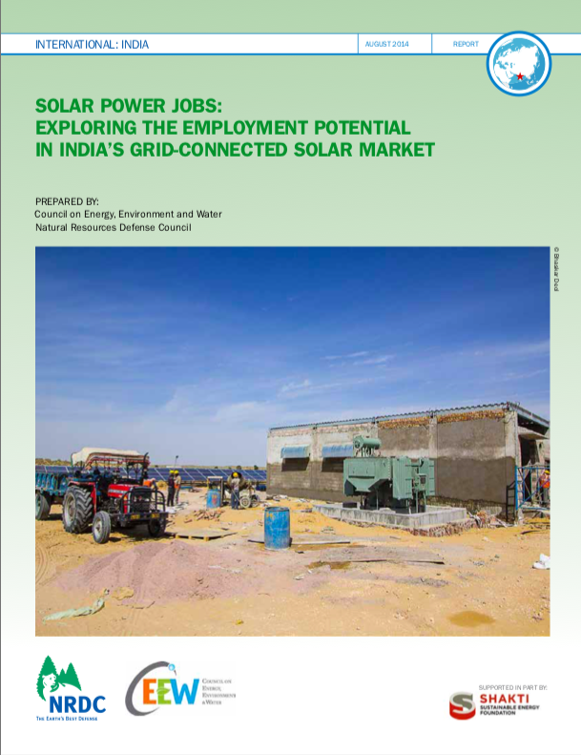
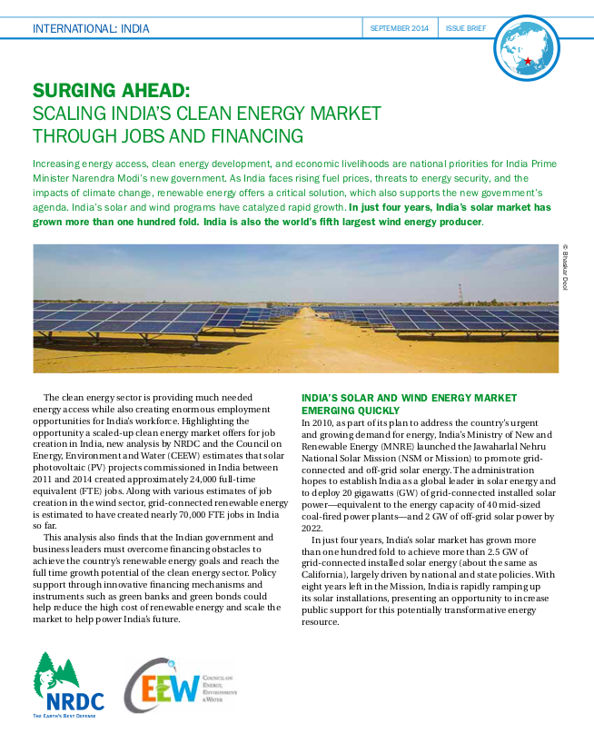
Green Jobs in India
Source: CEEW-NRDC-SCGJ, 2014, 2015, 2016, 2017, and 2019

Slide 4
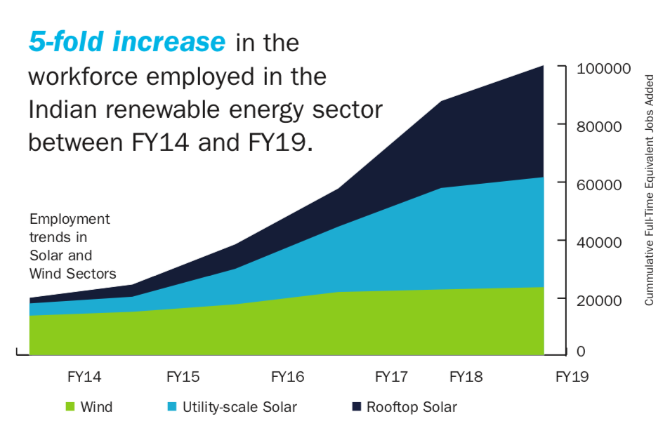
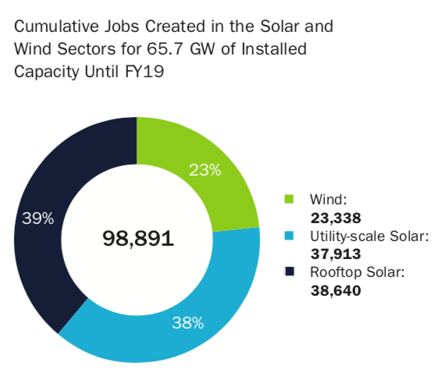
Cumulative Employment in the Solar and Wind Sectors Until FY19
Nearly 100,000 workers employed in solar and wind projects until FY19.
Rooftop solar employed the highest number of workers.
Source: CEEW-NRDC-SCGJ, 2019, Powering Jobs Growth with Green Energy
Source: CEEW-NRDC-SCGJ, 2019, Powering Jobs Growth with Green Energy

Slide 5
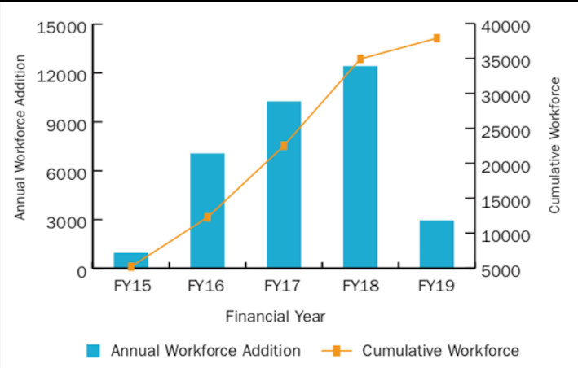
Employment Trends in Utility Solar
Annual Workforce Addition in Utility Solar
Slowdown in capacity addition has impacted employment
Source: CEEW-NRDC-SCGJ, 2019, Powering Jobs Growth with Green Energy
Source: CEEW-NRDC-SCGJ, 2019, Powering Jobs Growth with Green Energy

Slide 6
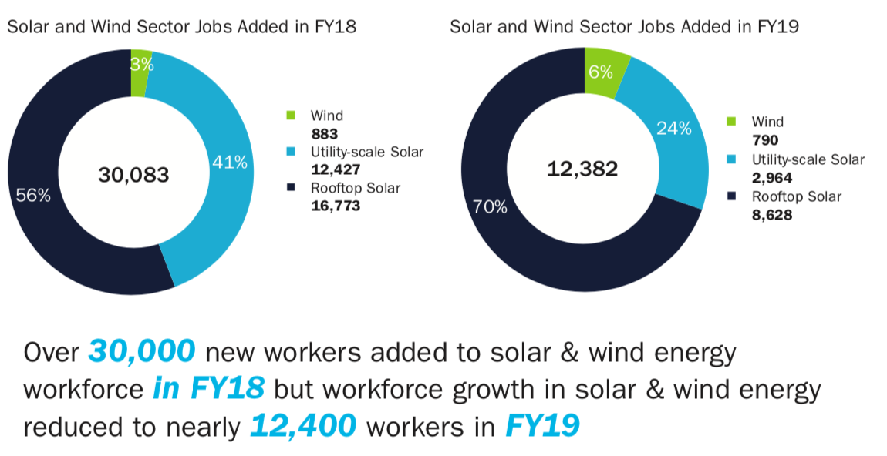
Additional Employment in FY18 over FY19
Source: CEEW-NRDC-SCGJ, 2019, Powering Jobs Growth with Green Energy
Source: CEEW-NRDC-SCGJ, 2019, Powering Jobs Growth with Green Energy

Slide 7
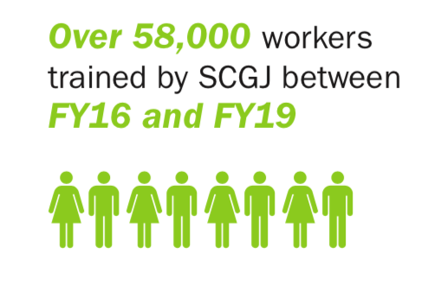
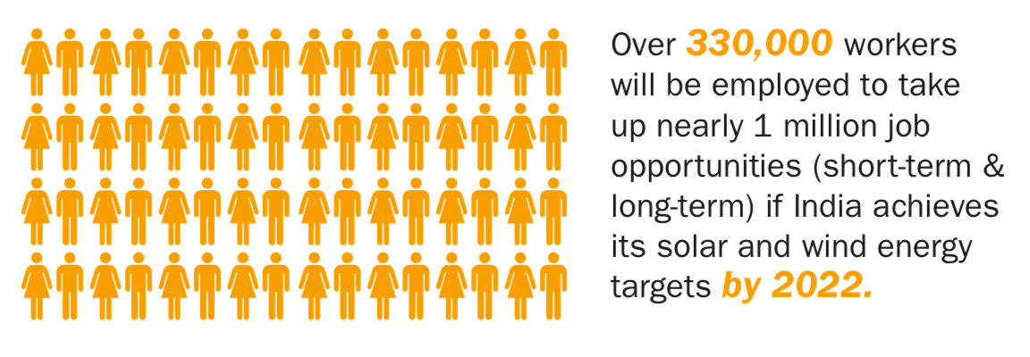
Training and Employment Potential
Over 230,000 new workers can be employed between now and 2022 in the solar and wind sectors if the 175GW of renewable energy targets are met
Source: CEEW-NRDC-SCGJ, 2019, Powering Jobs Growth with Green Energy
Source: CEEW-NRDC-SCGJ, 2019, Powering Jobs Growth with Green Energy

Slide 8
Recommendations
Increase support for Decentralized Renewable Energy projects | The mix of utility-scale RE and DRE projects India choses will be pivotal in employment trends in this sector.
Ensure steady renewable energy growth | To support clean energy job-creation and achieve India’s clean energy potential.
Support local training centers, particularly in the rural areas | To provide a specialized workforce needed by developers, to expand clean energy jobs across India, and to spur local green entrepreneurs.
Increase reporting on employment from RE companies | Encourage reporting by companies on the number of jobs created at every stage of the value chain and the kind of skills required to ensure market growth and political support over time.
Promote domestic solar module manufacturing industry | To boost employment since meeting the demand for solar modules required for 100 GW of solar capacity domestically, can employ an additional 45,000 workers.
Source: CEEW-NRDC-SCGJ, 2019, Powering Jobs Growth with Green Energy

Slide 9
Net Employment in the Power Sector

Slide 10
Three scenarios for assessing demand and employment within each energy sector
Reference Scenario INDC* Scenario Ambition Scenario
Source: TERI (2018)
*INDC: India Nationally Determined Contribution

Slide 11
Net employment in the power sector
Balanced share of conventional and non-conventional energy sources leads to maximum employment in INDC scenario
Source: CEEW – SCGJ, 2019

Slide 12
Net employment in the coal mining activities
As India transition to clean energy, employment in coal mining activities would decrease
India Nationally Determined Contribution (INDC)
Source: CEEW – SCGJ, 2019

Slide 13
Women working in rooftop solar sector: A look at India’s clean energy transition

Slide 14
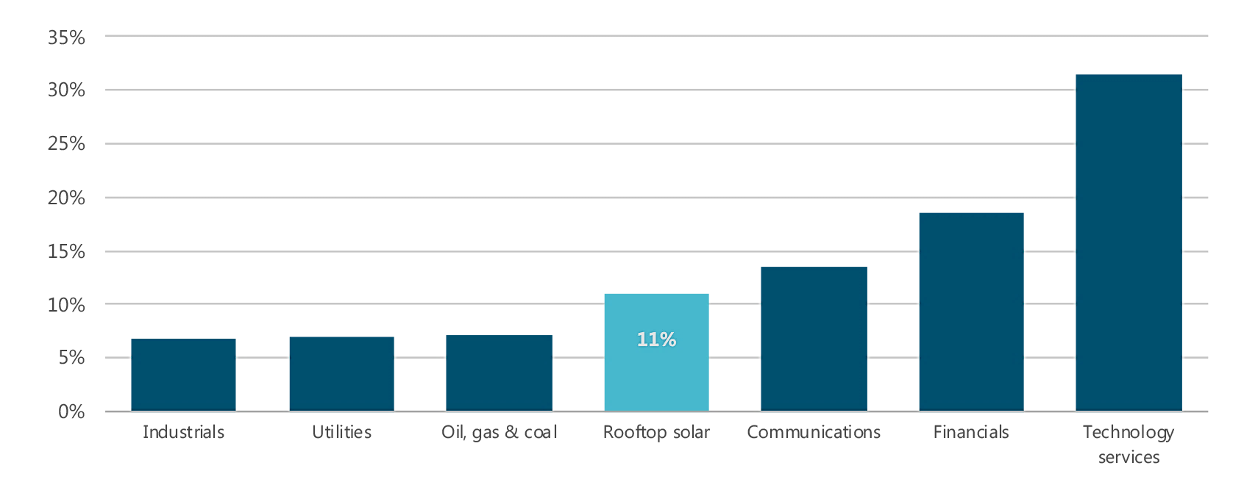
Women in the Rooftop Solar Sector
Women account for an estimated 11% of the workforce in the rooftop solar sector in India, significantly less than the global average of women in renewables sector (32%)
Higher than the proportion of women in other energy sectors in India - coal, oil and gas companies, and electricity utilities
The ratio of female employees in selected sectors in India
Notes:
Source: IEA-CEEW survey; company disclosure; Bloomberg LP (2019), Bloomberg Terminal.

Slide 15
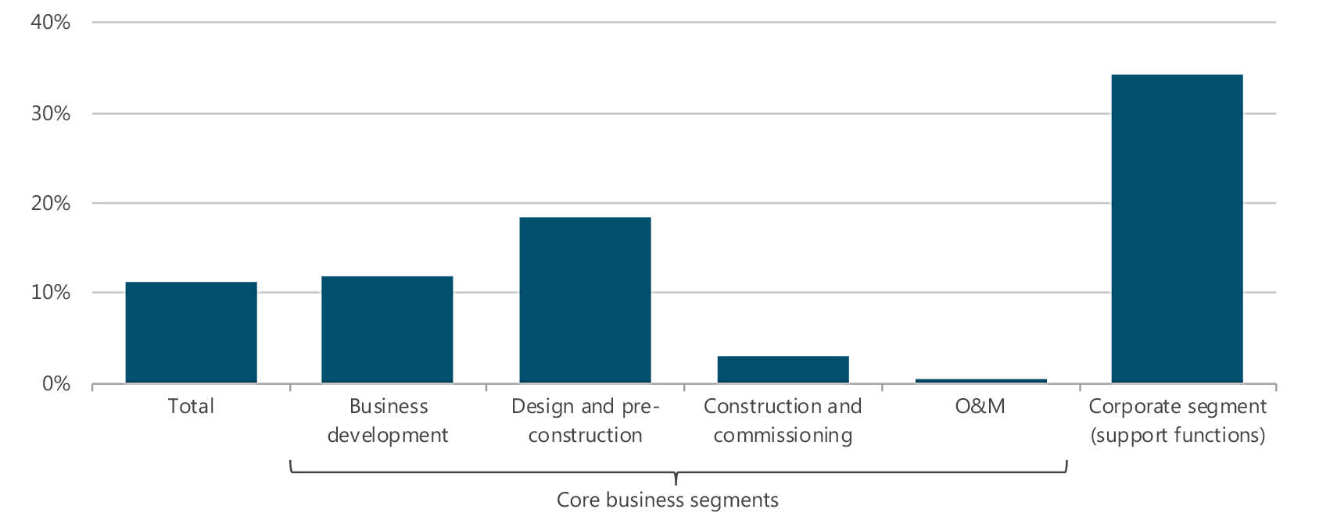
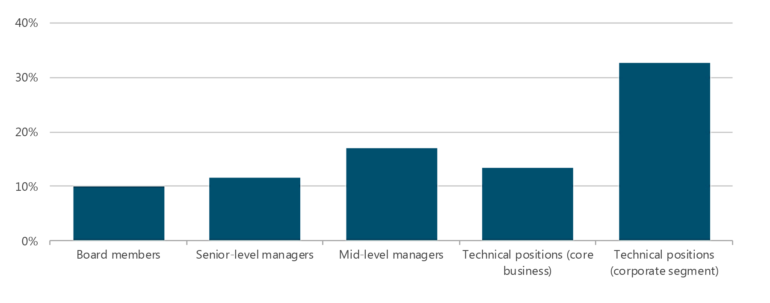
Gender diversity varies across the value chain and hierarchies
Share of female employees in India’s rooftop solar sector by segment
Share of female employees in India’s rooftop solar sector by position
.
Notes:
Source: IEA-CEEW survey
Note: Technical positions indicate positions classified as highly skilled jobs, for example, engineers and project managers in core business and accountants and HR specialists in corporate segment. The ratio of non-technical staff was asked in the survey but the responses are not displayed here due to the insufficient number of usable responses.

Slide 16
Existing barriers to and support for women’s participation in the sector
Individual
Individual consciousness
  Lack of ability to understand the gendered bias
  Sensitisation sessions and cultural diversity
Access to opportunities
  Adverse perception of safety and security at project sites
  Organisational support and mentorship
Informal
Formal
Norms and practices
  Masculine work culture
  Lack of long-term HR strategies
  Flexible work arrangements
Formal policies and procedures
  No policies on equal pay
  Lack of child-care facilities
  6 months maternity leave and prevention of sexual harassment
  Investor mandates on gender goals
Barriers
Support
Systemic
Source: Adapted from Gender at Work (2018), “Gender at work framework”.
Notes:
The framework highlights the interrelationship between gender equality, organizational change and institutions held in place by power dynamics within organisations.
The top two quadrants are related to the individual – what is the status of access to resources/opportunities available to women and the consciousness and learning of individual consciousness and capability (knowledge, skills, political consciousness, and commitment) of men and women to change towards equality. The bottom two clusters are related to the systemic. The cluster on the right refers to the set of formal policies procedures and arrangements to further gender equality. The cluster on the left is the set of informal discriminatory norms and deep structures, including those that maintain inequality in everyday practices - a collection of values, history, culture and practices that form the basis of organizational choices and behavior, that are gendered, kept in place by power structures and are often unquestioned.

Slide 17
The way forward – for enabling sectoral interventions
Companies
Investors
Policymakers
  Adopt progressive and flexible work policies
  Employee sensitisation through trainings and conversations
  Lending requirements to encourage gender audits
  Encourage companies to set internal goals on gender diversity across hierarchies
  Design gender inclusive policies
  Incentivise companies and investors to improve gender parity in their workforce

Slide 18
Points for Discussion
What are the challenges that exist in shaping gender inclusive policies and culture?
What are some of the best practices from within or outside the sector that companies can learn from?
What support do companies need from investors/policymakers to formulate policies and work culture that promotes greater participation of women in the sector?

Slide 19
Thank you
Join the conversation by using #EnergyHorizons
ceew.in | @CEEWIndia

