Slide 1
Acting on Many Fronts: Incentives and Regulations to Phase-down HFCs in India
Shikha Bhasin
National Dialogue on Phasing Down HFCs in India
India Habitat Centre, New Delhi
7 March 2019
© Council on Energy, Environment and Water, 2019

Slide 2
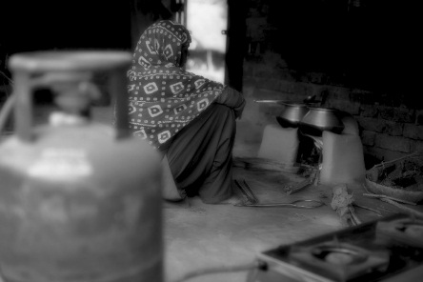

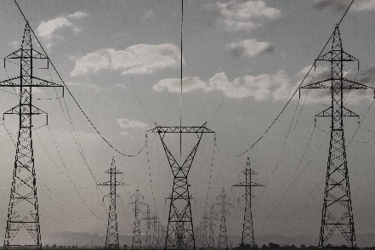

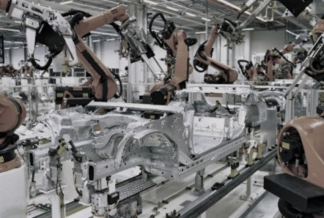

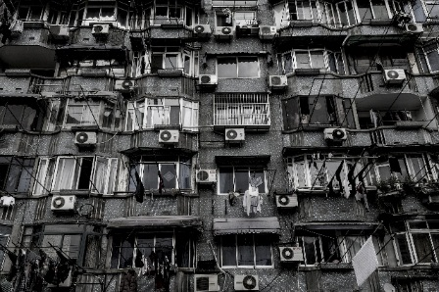

CEEW – Among South Asia’s leading policy research institutions
^{Energy Access}
^{Renewables}
^{Power Sector}
Industrial Sustainability & Competitiveness
^{Low-Carbon Pathways}
^{Risks & Adaptation}
^{Technology, Finance, & Trade}
^{Centre for Energy Finance}

Slide 3
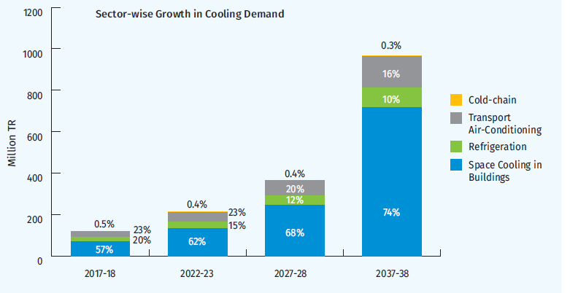
India’s cooling demand
Total cooling demand to increase 8-times by 2037-38 relative to 2017-18.
Among sectors, the building sector shows maximum growth (11-times baseline), followed by transport (5-times baseline) and cold-chain (4-times baseline).
Source: ICAP (draft), 2018

Slide 4
Meeting demand through low-GWP solutions
Technological opportunity: Technical mitigation potential of HFC/HCFC emissions is predicted to be 98% of BAU emissions.
Development opportunity: thermal comfort, productivity, cold chain, heat stress resilience, energy efficiency.
Learning from experiences: what were the challenges, what are the lessons?
Source: CEEW-IIASA, 2016

Slide 5
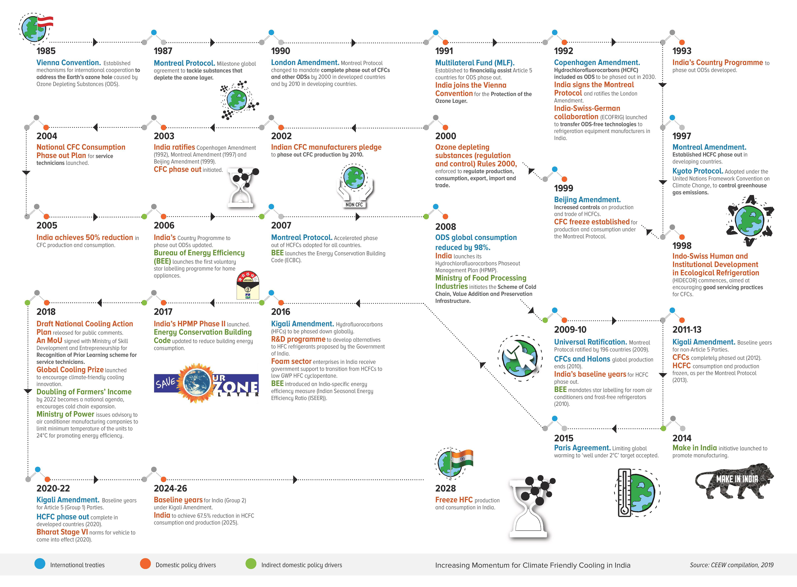
Increasing momentum for climate friendly cooling
Source: CEEW, 2019

Slide 6
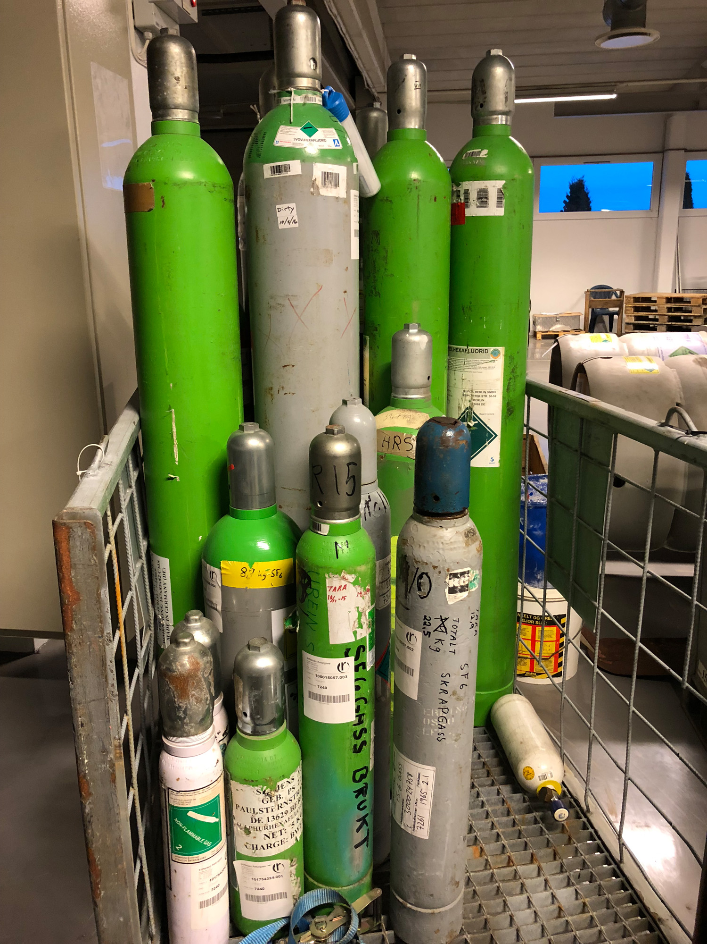
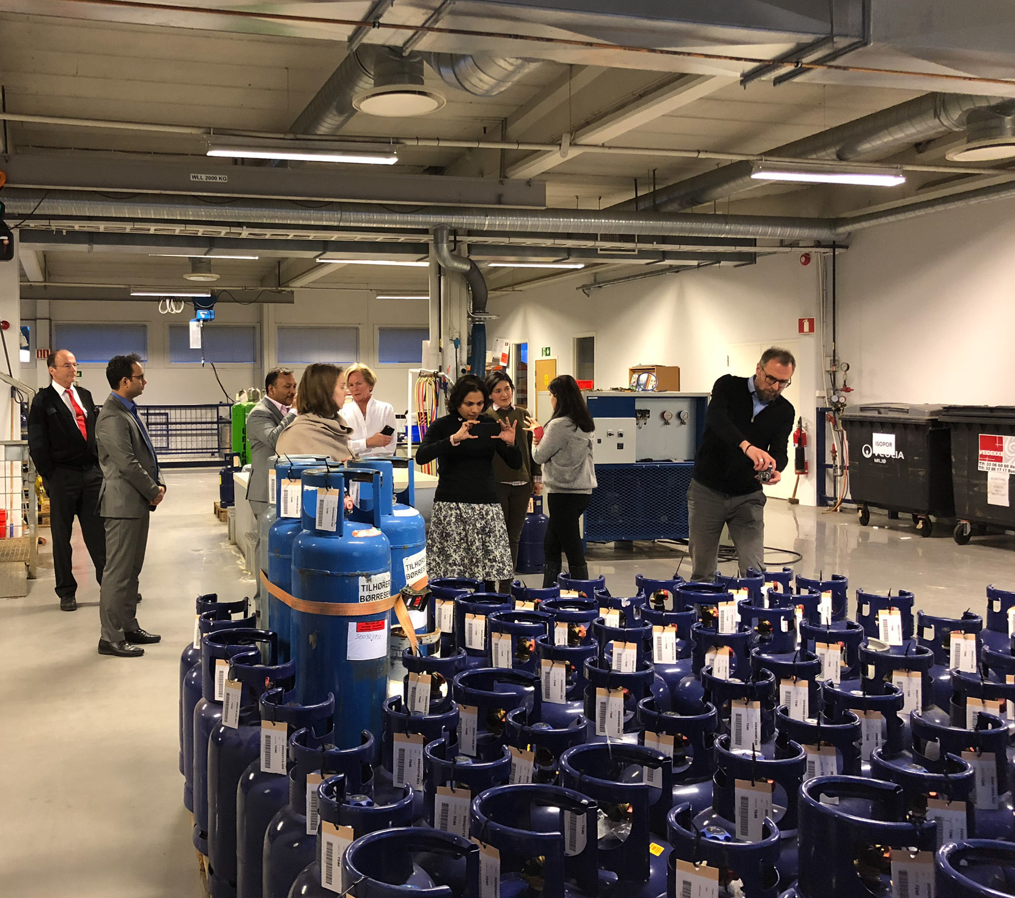
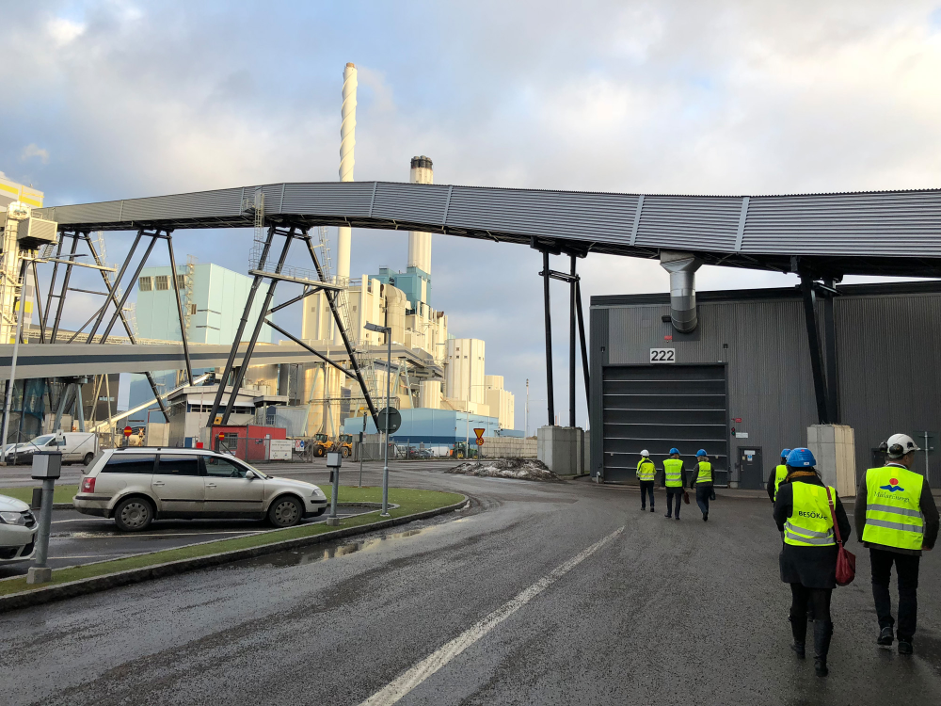
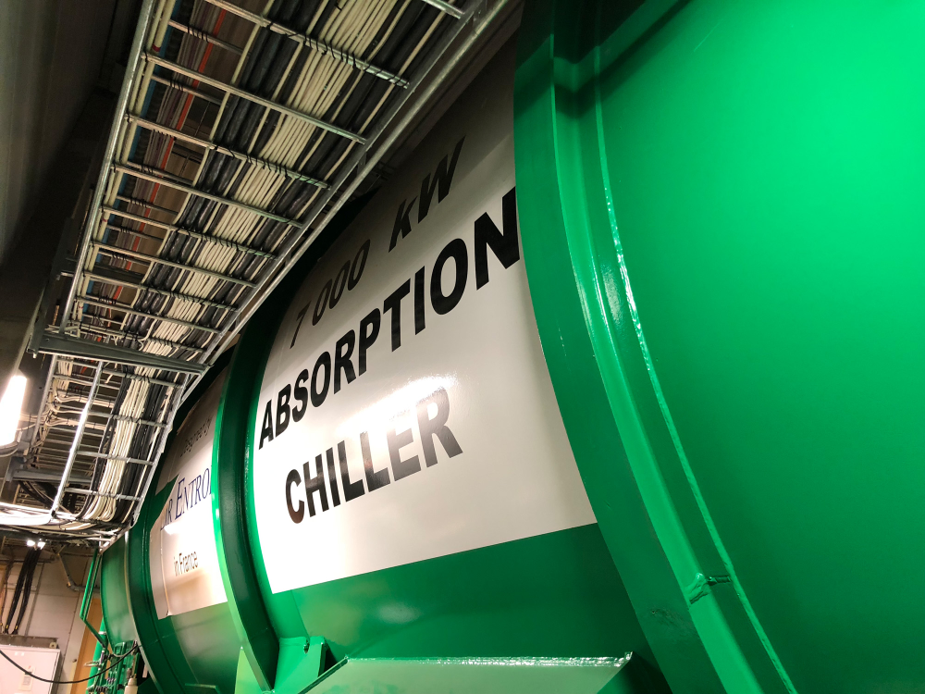
Key research questions
What policies and regulations do other countries have to phase-down HFC consumption and emissions?
Who are the different stakeholders in India (for example, HFC producers, equipment manufacturers, commercial building managers, service sector businesses, etc.)?
What are the challenges, and what actions will stakeholders need to undertake, to move towards low-GWP refrigerant alternatives, and to reduce operational and end-of-life disposal emissions of high-GWP HFCs?
What policy incentives and regulatory approaches can propel the actions of different stakeholders towards an accelerated transition away from high-GWP HFCs?
Source: CEEW, 2019

Slide 7
Stakeholders interviewed
Members of the Ozone Cell and national and international experts: Policies for India from global best practices
60 industry representatives: Challenges and Policy Preferences
Source: CEEW, 2019
Notes:
The classification of companies by size was done based on turnover data. As per a recent government definition reported by Prasad (2018), businesses with annual turnovers of INR 5–75 crore (approximately USD 0.7 million – USD 10.7 million) are small and those with INR 75–250 crore (approximately USD 10.7 million – USD 35.7 million) turnovers are medium-sized enterprises. For our study, we have considered businesses with annual turnovers of more than INR 250 crore (greater than USD 35.7 million) as large companies.

Slide 8
Policies for refrigerant transition
Quotas/ Cap and phase-down
Tax and refund
Limit on GWPs, with incentives for low-GWP refrigerant usage
Environmental cess
Subsidies for using low-GWP refrigerants
Least Impactful | Not Impactful | Neutral | Mildly Impactful | Most Impactful
Least desirable | Not desirable | Neutral | Mildly Desirable | Most Desirable
Source: CEEW, 2019

Slide 9
Policy preferences and perceived impact
Source: CEEW, 2019

Slide 10
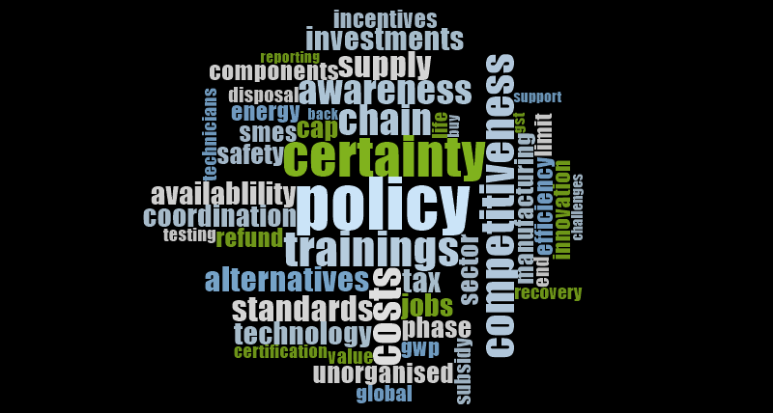
Industry challenges
Notes:
Methodology: Codes
Axial Codes
Assessing Hierarchies

Slide 11
Key Challenges to India’s HFC Phase-down
Policy Uncertainty
Investments
R&D
Manufacturing: refrigerants and components
Supply Chain
Refrigerant alternatives: information, availability, standards, affordability
Component availability and readiness
Service sector readiness
End of life disposal
Policy coordination
Effective policy implementation
Consumer awareness

Slide 12
What Industry Wants: A Call to Action
Policy certainty
  Industry investments justification
  Supply chain preparedness
Information packages
  Industry
  Consumers
  Service Sector
Policy coordination
  Make in India
  Energy Efficiency Mission
  Doubling of Farmers Income
  Skill India Mission
  Quick window for standard development with Bureau of Indian Standards

Slide 13

Thank you and we look forward to welcoming you in Delhi!
ceew.in | @CEEWIndia

Slide 14
Thank you
ceew.in | @CEEWIndia

