Slide 1

#PoweringJobs
A Global Campaign to Build an Energy Access Workforce
Power for All
Energy Horizons, New Delhi
18 July 2019
Session Partners
© Council on Energy, Environment and Water, 2019, Power for All, Skill Council for Green Jobs

Slide 2
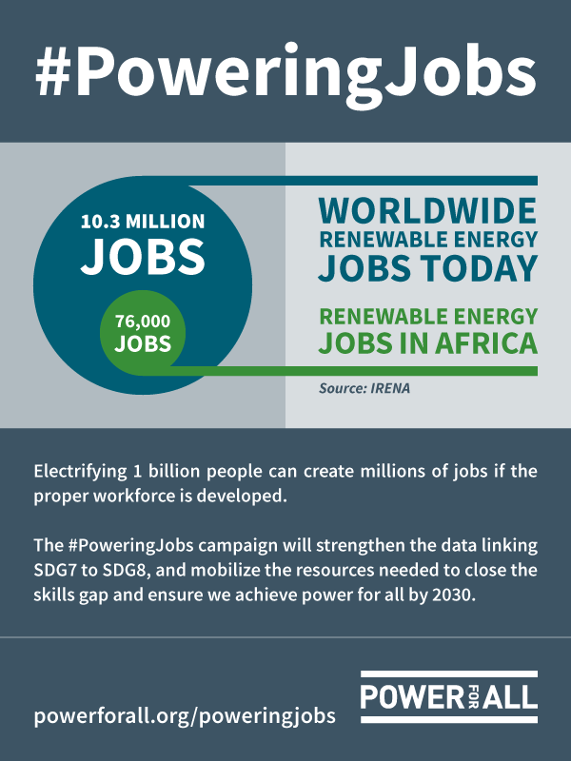
Putting Energy Access to Work
Up to 20,000 decentralized renewable energy (DRE) companies are needed to power SDG 7 by 2030.
The off-grid value chain could create 4.5 million jobs globally by 2030 – including sales, installation, service, appliances.
The majority of renewable energy jobs are outside of low energy access countries (less than 1 percent in Africa of global 10.3 million).
There is a dearth of workforce with the technical, financial and managerial skills needed for DRE in low energy access countries.
The global community must develop knowledge and interest in DRE sector, along with technical and vocational training (TVET), to create the workforce needed — or we will be unable to power SDGs.

Slide 3
#PoweringJobs: Campaign Overview
OBJECTIVE: To advance fiscal and institutional support for decentralized renewable energy (DRE) skills and trainings that will ensure the diverse, inclusive human capital needed to power SDG7, create a just energy transition and fill new jobs in low-energy access countries.
AWARENESS: Data shows that DRE markets can create positive social impact on energy access and employment.
ADVOCACY: Grow support within target institutions for financial, policy and programmatic support for DRE training and education.
ACTIVATION: Demonstrate new opportunities for youth and women (connect the skills set need for DRE to energy sector more broadly).
STEPS:

Slide 4
Research Scope
#PoweringJobs

Slide 5
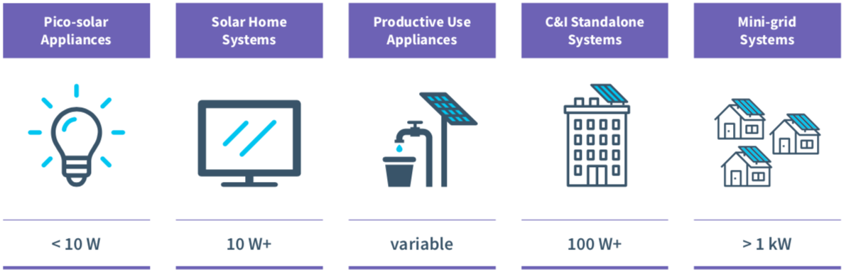
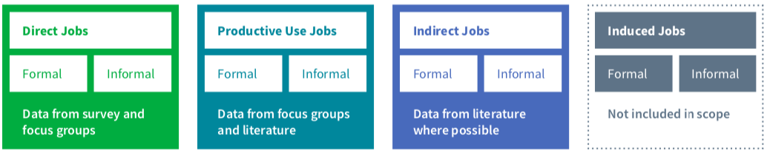
Research Scope
TECHNOLOGY
JOB TYPE

Slide 6
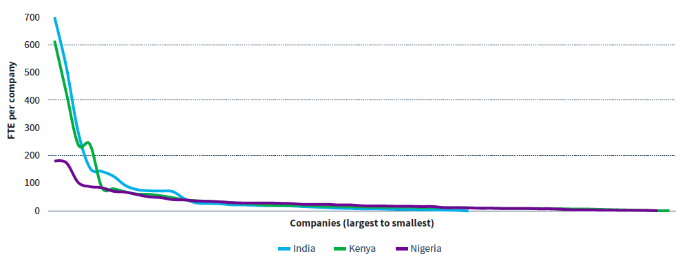
Sample
RESPONDENTS
There were 130+ survey respondents from the following sectors:
End-user product providers
Project developers and installers
Mini-grid operators
Manufacturing and upstream supply chain
Sector service providers
DISTRIBUTION
In India, 81% of the jobs are created by companies in the top quartile by number of full-time equivalent jobs; in Kenya 80%; Nigeria 64%
In India and Kenya, the market is led by a few large players; where as in Nigeria, job creation is more evenly contributed by different actors

Slide 7
Key Output Metrics
JOBS ESTIMATES AND PROJECTIONS
Full-time equivalent (FTE) direct formal jobs estimate and projection
Direct informal jobs estimate and projection
Productive use jobs estimate
WORKFORCE CHARACTERISTICS
Gender balance
Youth participation
Job function breakdown
Recruitment challenges
Wage and compensation
Level of engagement
RECOMMENDATIONS
Key recommendations for DRE on local capacity building, gender inclusion, and youth employment

Slide 8
JOBS ESTIMATES
#PoweringJobs

Slide 9
Jobs Estimates
2017-2018
The scale of DRE direct formal workforce is already on the order of traditional power sector or utility-scale solar
In addition to direct formal jobs, the DRE sector employs 2x–5x more people through indirect jobs and productive use jobs

Slide 10
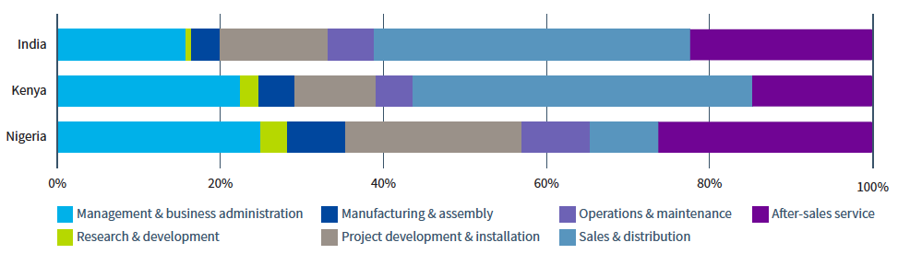
Job Functions Breakdown
2017-2018
In India and Kenya, approximately 40% of the jobs are in sales and distribution
In Nigeria, project development and installation make up a large part of the workforce
In all three countries, management and business administration is an important part of the workforce

Slide 11
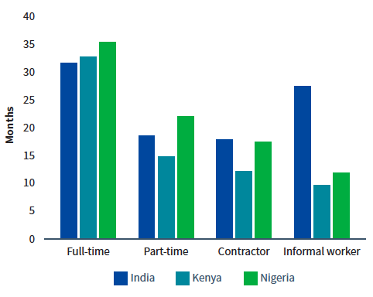
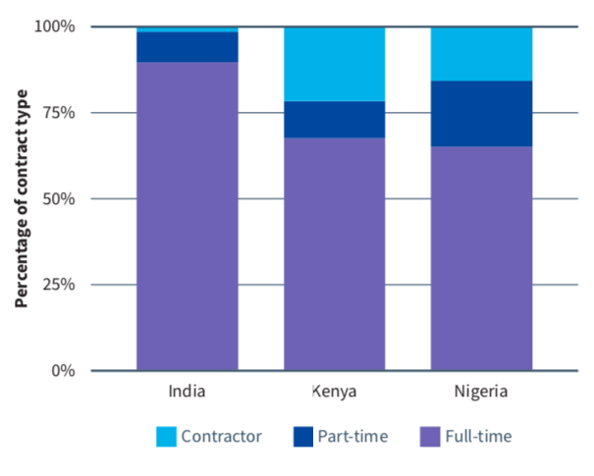
Job Permanence
The DRE sector provides full-time, long-term jobs. Average retention is more than 30 months across the board and the majority of direct formal jobs are full-time jobs.
Average Retention in Months
Level of Engagement

Slide 12
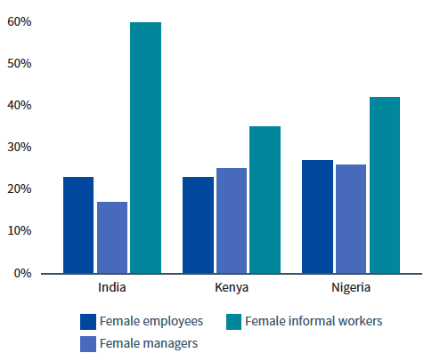
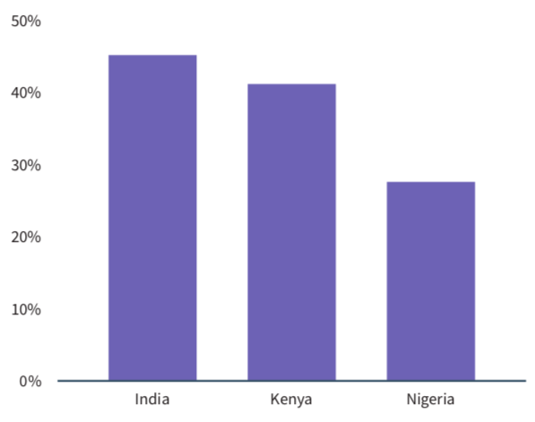
Women and Youth
About a quarter of the direct, formal jobs are taken up by women, as compared to 32% for the global renewable energy sector. Women constitute higher percentage of the informal workforce.
Youth participation is high. Companies express strong interest in hiring young people.
Women
Youth

Slide 13
JOBS PROJECTIONS
#PoweringJobs

Slide 14
Jobs Projections
2022-2023
DRE direct, formal jobs will about double in India and Kenya, and grow by more than 10 fold in Nigeria
Informal jobs may grow, but not as fast as direct, formal jobs

Slide 15
Jobs Projections By Technology
Solar appliance and SHS companies were the job engine of the sector in 2017–18, providing the largest number of direct, formal jobs and the largest number of informal job opportunities.
Under a high mini-grid penetration scenario of 500 MW, total direct, formal jobs may almost double to 190,000 by 2022–23.
Total informal jobs by 2022–23 may not grow very significantly; mini-grids may contribute about 4% of informal jobs by 2022–23.
Solar water pump companies will also be an important employer, as the GoI shifts focus to subsidizing solar pumps through KUSUM.

Slide 16
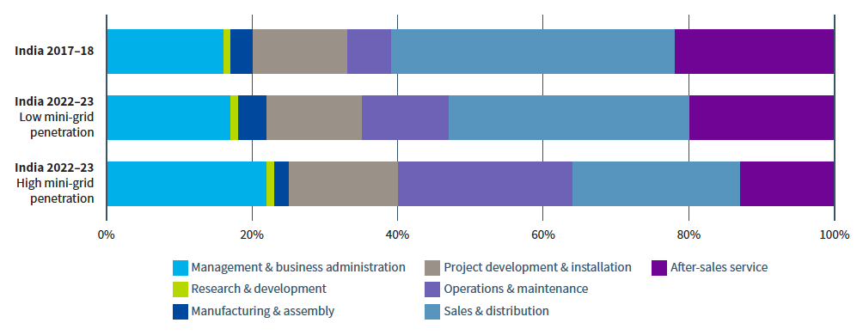
Job Projections
MINI-GRID PENETRATION SCENARIOS AND SKILLS
The higher the mini-grid market penetration, the more management and business administration and O&M skills would be needed.
Since pico solar appliance and SHS companies are in need of sales and distribution and after-sales service talents, the growth of these jobs are linked to the growth of these companies.

Slide 17
Conclusions
The direct, formal workforce in the DRE sector may double in size between 2017–18 and 2022–23 if the mini-grid market continues to expand at a rapid pace.
In addition to direct, formal jobs, the Indian DRE sector has significant employment impact on the informal sector.
Government support of productive use applications such as solar water pumping could add about 10,000 additional jobs.
Skills needs will depend on the evolution of the sector, with an expected shift from sales and distribution to O&M.
Women’s participation in almost every type of DRE company is low, except for sector service providers. All companies in the DRE sector show high willingness to employ young people.

Slide 18
Thank you
Join the conversation by using #PoweringJobs
powerforall.org | @Power4All2025

